Slide 1
An Analysis of the Socio-Economic Impact of Opioid Use in the United States
Team 2
Austin White,
Rylan Hunter,
Mayank Jaggi

Slide 2
Who be poppin pills, and where they be gettin’ them?

Slide 3
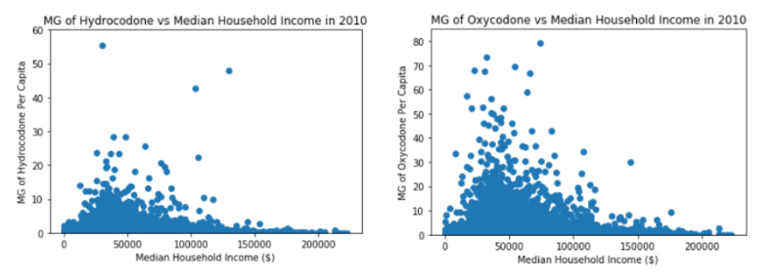
MG of Opioids per Capita vs Median Income

Slide 4
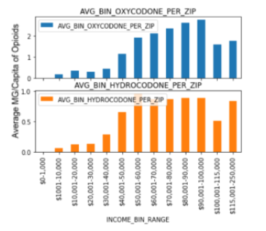
Average MG of Opioids Per Capita vs Median Income

Slide 5
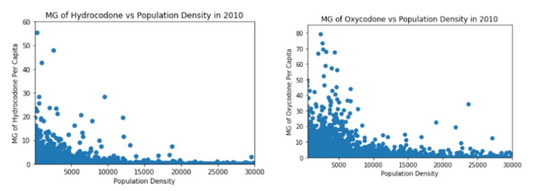
MG of Opioids per Capita vs Population Density

Slide 6
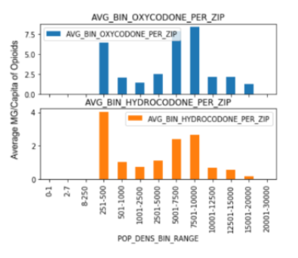
Average MG of Opioids Per Capita vs Population Density

Slide 7
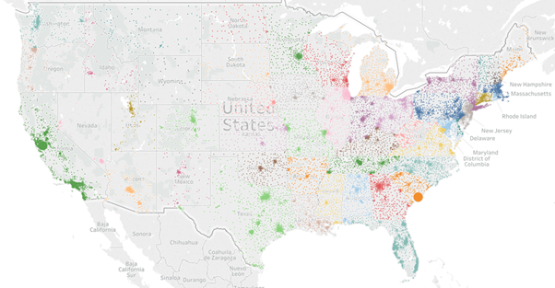
Heat Map of Total Opioids Across U.S.

Slide 8
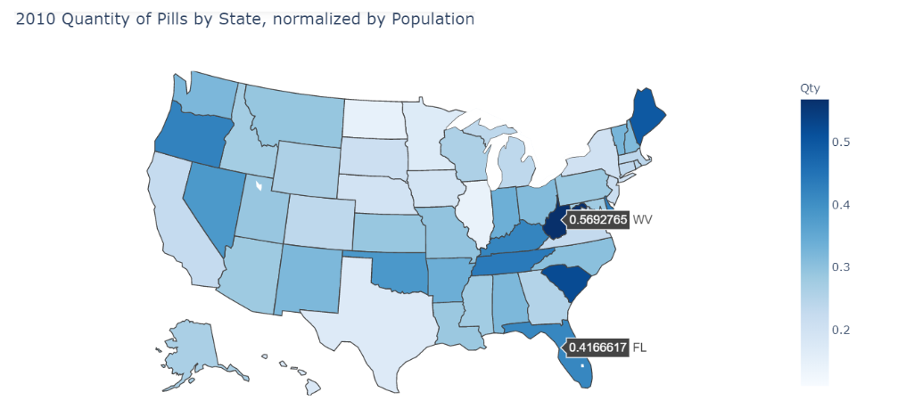
Amount of Opioids per State (normalized by population)

Slide 9
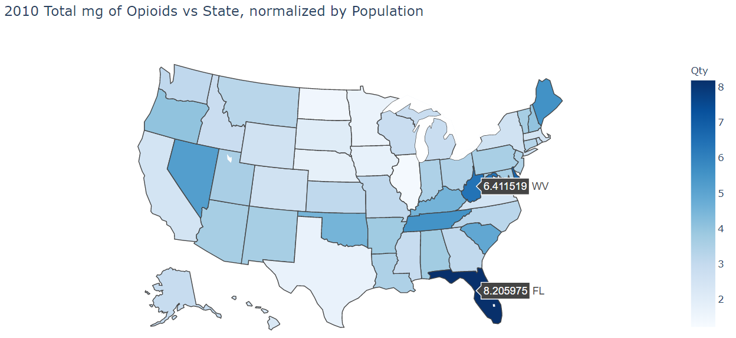
MG of Opioids per State (normalized by population)

Slide 10
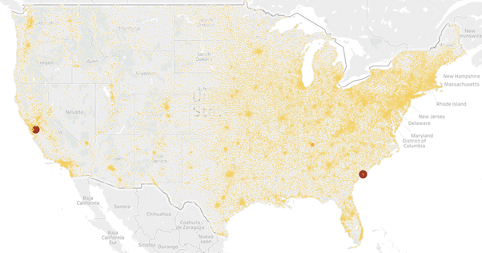
MG of Hydrocodone by Zip
Notes:
Maximum consumption of Hydrocodone is in the following cities (size of the circle and color
indicates the mg consumed):
● Charleston (SC)
● Livermore (CA)
● Murfreesboro (TN)
● Downey (CA)

Slide 11
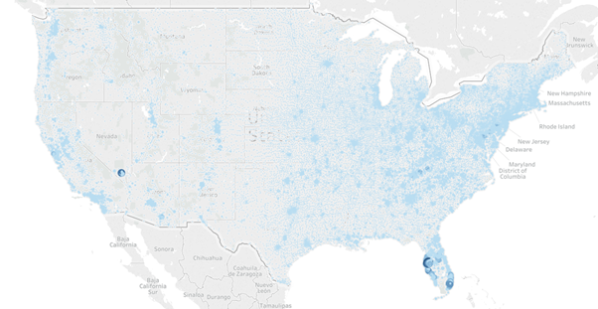
MG of Oxycodone by Zip
Notes:
Maximum consumption of Oxycodone is in the following cities (size of the circle and color
indicates the mg consumed) :
● Las Vegas (NV)
● Tampa (FL)
● Ft Lauderdale (FL)
Knoxville (TN)
● Hallandale (FL)

Slide 12
Questions?

